Slide 1
Food Classification
Jiang Yue, Park Yeo Eun
Introduction
Motivated by class contents, we tried to make a Food Classification program using deep learning method ‘Convolutional Neural Nets’, with MATLAB.
Research Question
How much accuracy can we obtain with simple CNN to classify the Food images?
Notes:
(Simple team-introduction…) Motivated by class contents, we tried to make a Food Classification program using deep learning method ‘Convolutional Neural Nets’, with MATLAB. Our research question was, “How much accuracy can we obtain with simple CNN to classify the Food images?”

Slide 2
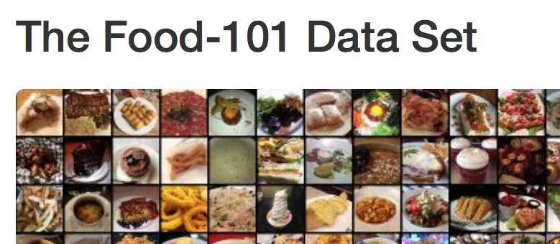
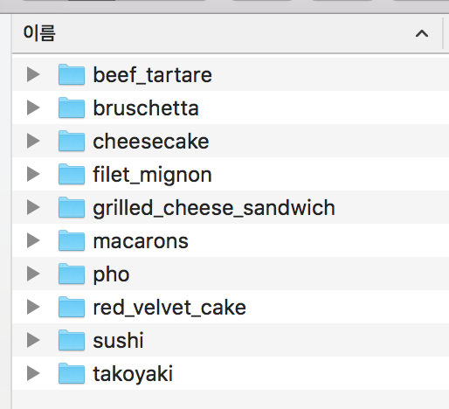
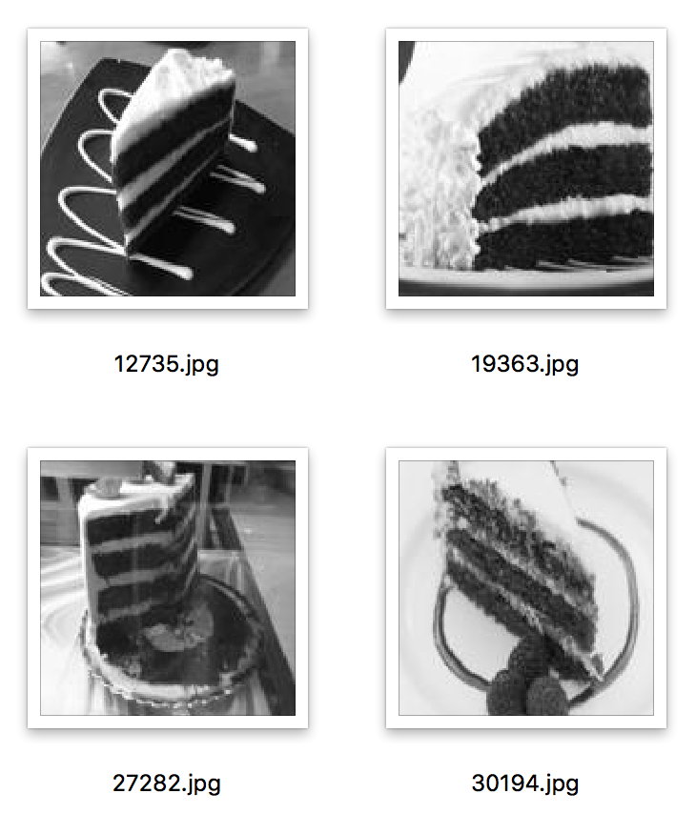
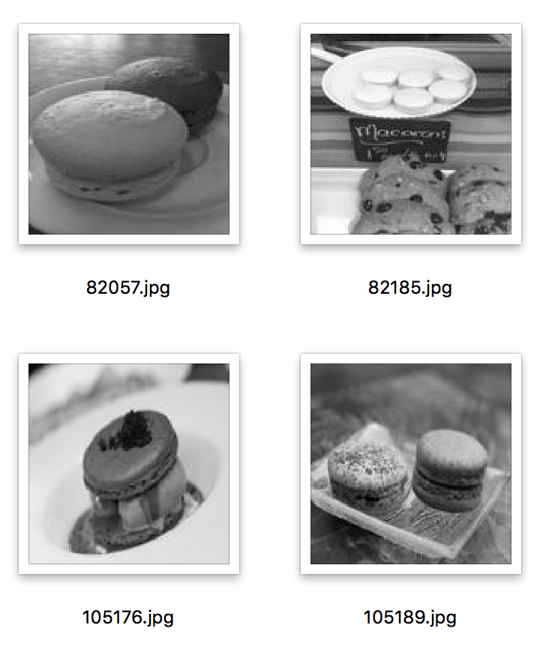
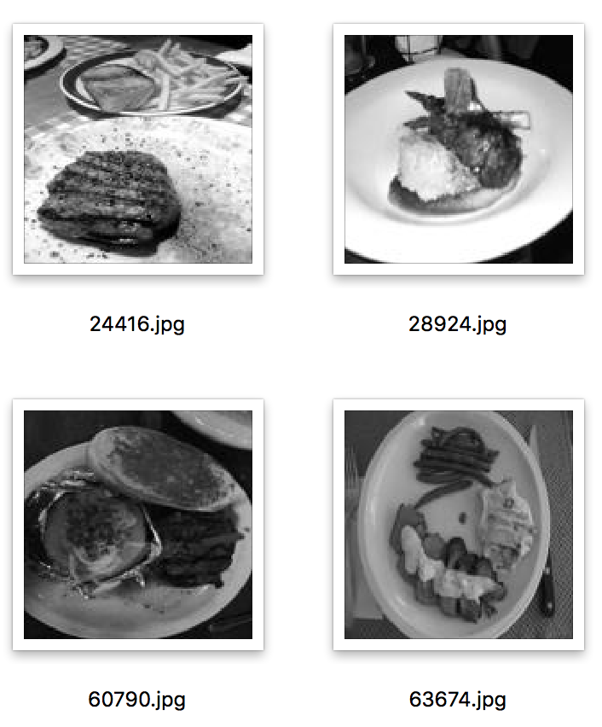
Food Classification
Dataset Introduction – The Food-101 Dataset
The Food-101 Dataset is a dataset of 101 food categories, with 101,000 images.
We used 10 classes of this dataset.
Class of ‘cheesecake’
Class of ‘macarons’
Class of ‘bruschetta’
Notes:
To make the training set for Food Classification, we used the Food-101 Dataset. It is a dataset of 101 food categories with 101,000 images. For each class, 250 manually reviewed test images are provided as well as 750 training images. We used 10 classes of this dataset and there are 990 images for each label in the training dataset. All images were rescaled to have a maximum side length of 512 pixels. The sizes of the images were not standardized so we make our code to fix their sizes 128*128.

Slide 3
Food Classification
Algorithm Introduction
CNN
128
128
128
3
128
3
10
16
16
16
32
32
Notes:
To specify training and validation sets, we used 750 images for training and 240 images for validation for each labels. And 5 convolution layers and 1 fully connected layer to avoid overfitting were used to define CNN architecture. For specifying training options, we used adam method to update the weights. Through our experiments, we used 0.0001 learning rate to get a proper converge speed and 10 epochs to get more accurate result.

Slide 4
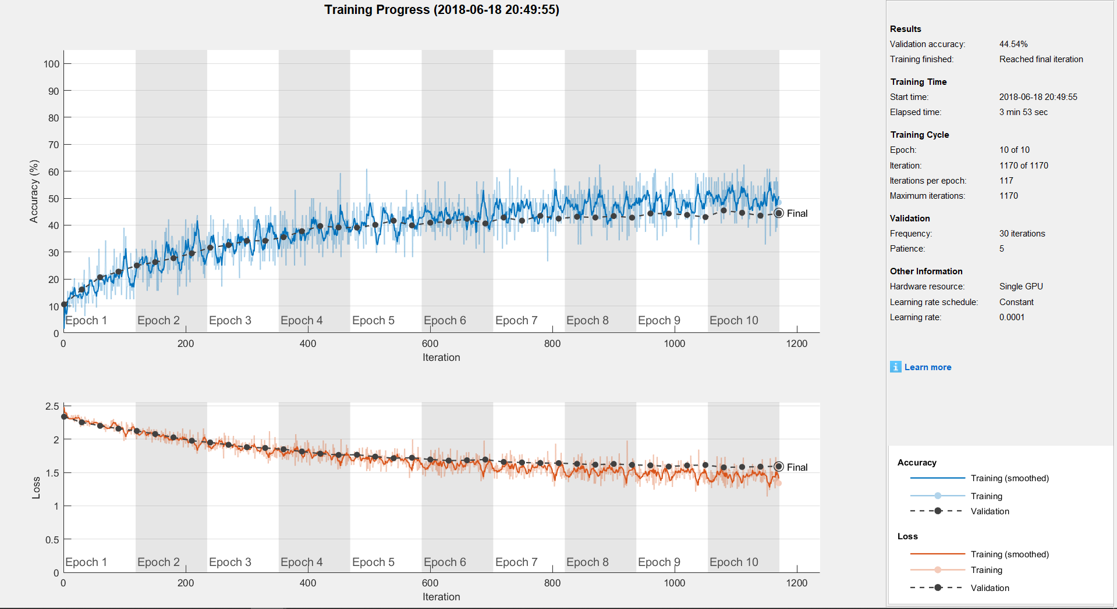
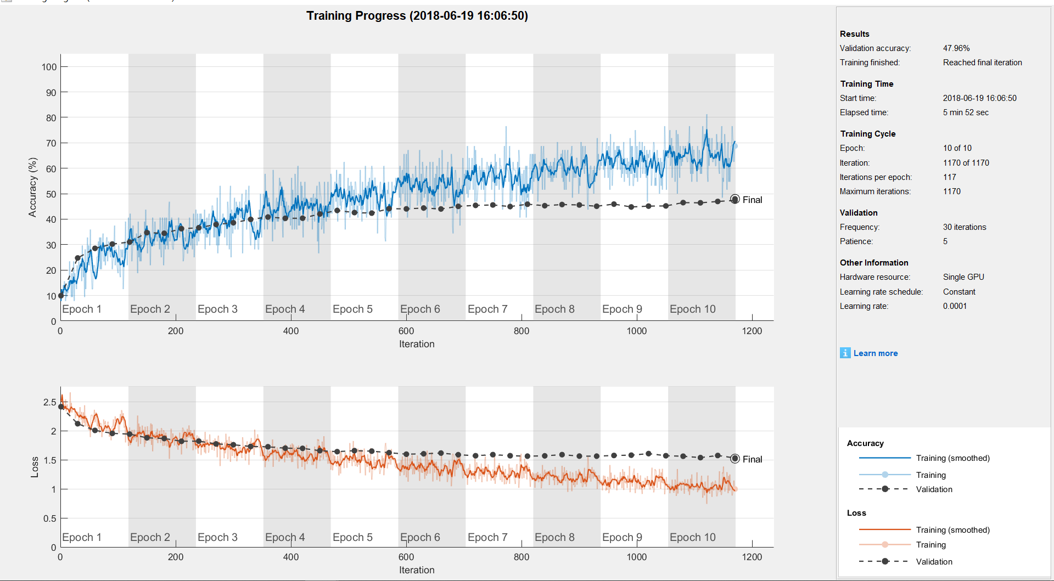
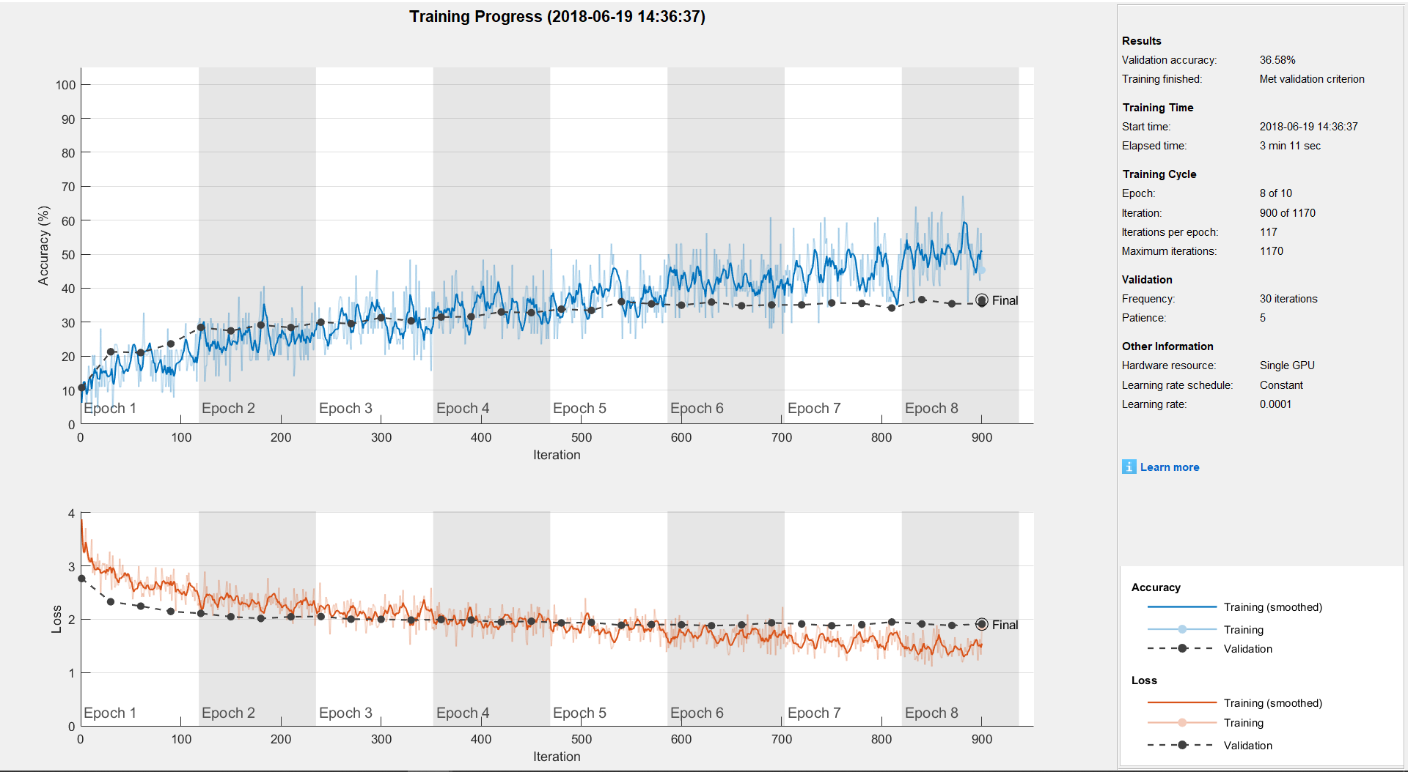
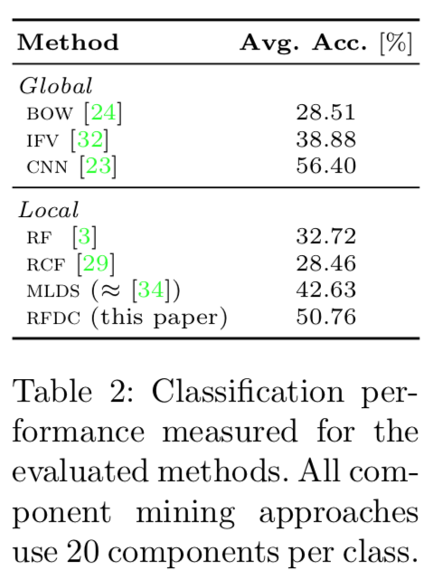
Food Classification
Result with Training Set
Fig.2.
3 convolution layers and 1 fully connected layer, and the number of filters in each convolution layer is 16,32,32
Fig.3.
5 convolution layers and 1 fully connected layer, and the number of filters in each convolution layer is 32,32,64,128,128.
Fig.1. 5 convolution layers and 1 fully connected layer, and the number of filters in each convolution layer is 16,16,16,32,32
(Lukas Bossard et al.)
Notes:
We defined three kinds of CNN architectures with different complexity, and compared their speed and performance. And we also added a dropout layer before the fully connected layer to avoid overfitting.
1. CNN with 5 convolution layers and 1 fully connected layer, and the number of filters in each convolution layer is 16,16,16,32,32. This one is relatively simple and has comparable accuracy (about 45%).
2. CNN with 3 convolution layers and 1 fully connected layer, and the number of filters in each convolution layer is 16,32,32. This one is the simplest one because it only has three convolution layers. But the accuracy is much lower than others (about 35%).
3. CNN with 5 convolution layers and 1 fully connected layer, and the number of filters in each convolution layer is 32,32,64,128,128. This one is the most complicated one because of much more filters in each convolution layer. But by simply increasing the number of filters, we observed that the final accuracy has litter improvement (about 45%~50%). Considering the experiment results in the paper, which was about 56% via a much more complicated CNN architecture, we guess that the complexity of the original dataset might make the classification difficult. So the final accuracy would be limited (lower than 50%) by just using the simple CNN architecture like our experiments.

Slide 5
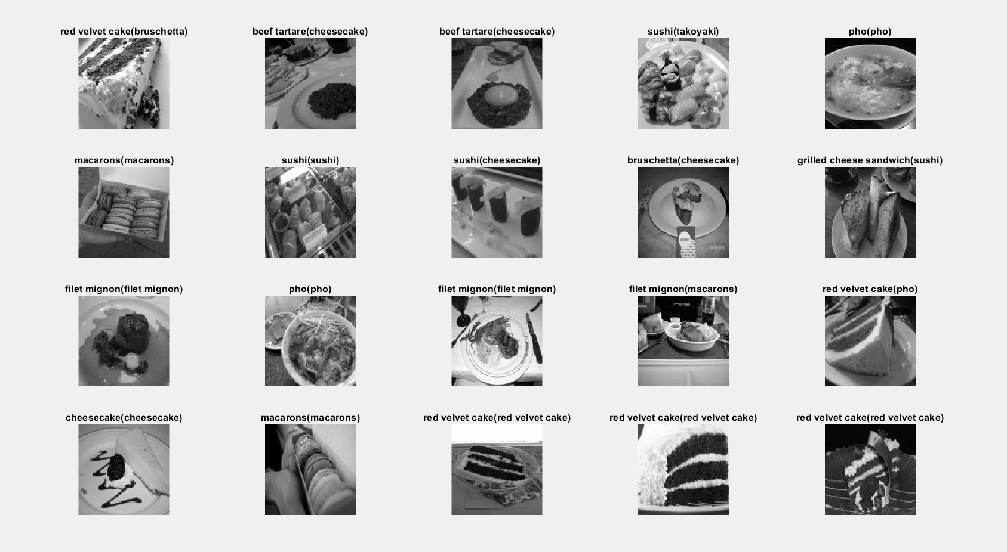
Food Classification
Result with Testing Set
Notes:
And this is the result with testing set, you can see the 5, 6, 7, 11, 12, 13, 16, 17, 18, 19, 20 is successfully classified.

